Slide 1

Linux introduction

Slide 2
Operating Systems
Microsoft Windows
Linux 500+ distributions
(Redhat / Ubuntu /CentOS/ Suse / Mint / Alma /Rocky …)
AIX from IBM
MAC OS from Apple

Slide 3
Linux Evolution
Started in 1990 by Linus Torvalds
Powering 100% top supercomputers (top500.org)
96% of servers worldwide
Android devices
GPL license adoption
Kernel 1.0 in 1994

Slide 4
Linux Evolution
Major companies adopted linux like IBM/DELL
2004: desktop accessibility
2005: GIT control
2010: cloud computing, DevOps and mobile technology

Slide 5
Key Components
Kernel and GNU
Distributions
Open Source

Slide 6
Roots in unix OS
Beginning of unix
1972: Thompson & Richie re-wrote unix in C
Berkely Software Distribution
NeXT OS > mac OS
Minix > Linux
Variants: HP-UX from HP
Solaris from Sun Micro(oracle)
AIX from IBM

Slide 7
Features of Unix
Clarity
Portability
Multi-sharing/Multi-tasking/Multi-user OS

Slide 8
Features of Linux
Free and Open- Source
Monolithic Kernel
SMP Support
Kernel is independent
CLI and GUI interface

Slide 9
Features of Linux
Over 500+ distributions
Distros tailored for diverse needs
Free and subscription based
Popular (ubuntu/redhat/rocky/suse/fedora/centos/kali/alma etc)
CLI and GUI interface
Package manager
Co-existence with other OS

Slide 10
Linux Hardware
Bare minimum
  1 GB RAM
  10 GB HDD
  16bit processor
  Runs on high end Super Computers

Slide 11
Features of Linux
Multi-user capability
Multi-tasking capability
Communication
Security
Portability

Slide 12
Functions of Linux
Server OS
Desktop OS
Software Development OS
Embedded OS
Open-Source OS
Cluster OS

Slide 13
Linux Applications
DNS Server
DHCP Server
Web Server
HPC Cluster
Firewall
Cloud Servers
Many more……

Slide 14
Linux used in
Internet
Mobile Devices
Network Devices
Desktops & laptops
Super Computers (top500)
Raspberries
Electronic watches
Many more…..

Slide 15
Linux why
Open Source and Free
Multiuser and Multitasking OS
Robust and Reliable
Scalable and portable
Scalable – Processor counts, Users, Memory, I/O etc
Portable – works efficiently on Wrist watch to Super Computers

Slide 16
Best Linux distribution
Based on
Application
Hardware support
User friendly
Community Support
Knowledge base
User experience

Slide 17
Linux - disadvantages
More distributions are available ( New/outdated).
Choice depends on user requirements and experience.
Official support needs subscription
Applications compatibility between windows and linux
Some application become obsolete or no further developments.
Community Support dependency.
New users find Windows OS more easy and comfortable.
Administration difficulty due to change in command names/paths

Slide 18
GNU & GPL
General Public License
To provide free software
GPL is license for GNU Project

Slide 19
Relationship – GNU & GPL
Copyright
Freedom
Versions
usage

Slide 20
Linux with GNU
Linux distribution = Linux kernel + GNU tools
Linux/GNU maintained by FOSS
Linux provides Kernel
GNU Provides
  Applications
  Tools and libraries

Slide 21
Linux with GNU
Stability
Free and opensource
Wide range of hardwares
Security
Community Support
Vast knowledge base

Slide 22
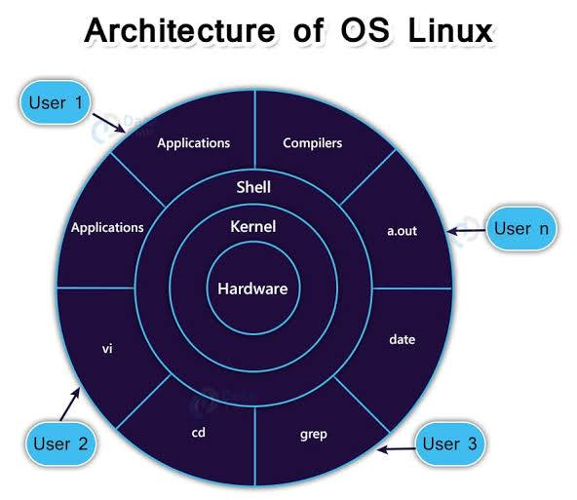
Linux Architecture

Slide 23
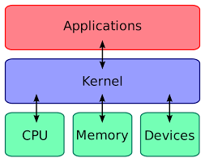
Linux Architecture

Slide 24
Linux Architecture
Hardware Layer: Consists of all physical components: CPU, RAM, hard drives, and peripheral devices.
Kernel: The heart of the OS, acting as a bridge between applications and hardware. It manages memory, processes, file systems, and device drivers. Linux uses a monolithic kernel.
System Call Interface (SCI): A critical interface allowing applications in User Space to request services from the Kernel (e.g., opening files, creating processes).
System Libraries (glibc): Provide functions that allow applications to invoke kernel features without needing to know the low-level system call instructions.
Shell/User Applications: The top layer where users run commands (bash, zsh) or applications (web browsers, text editors).

Slide 25
Linux Architecture
User Space
Kernel Space
Monolithic Kernel
Device Drivers
File Systems

Slide 26
Linux Shells
C Shell
Korn sh
BASH
Bourne Sh
Z Shell
Fish

Slide 27
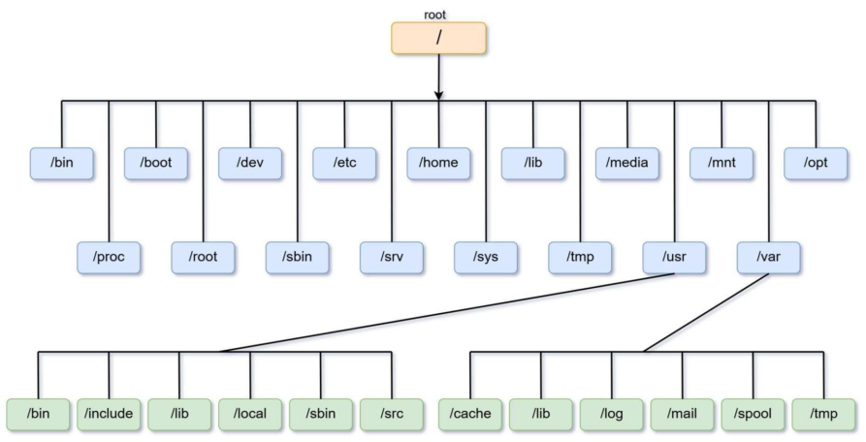
Linux Filesystem

Slide 28
Linux Filesystem characteristics
Space Management
Filename
Directory
Metadata
Utilities
Design

Slide 29
Advanced features of FS
Journaling
Versioning
Inode

Slide 30
Types of Filesystem
Ext (1,2 3,4)
XFS
ZFS
ReiserFS
JFS
NTFS

Slide 31
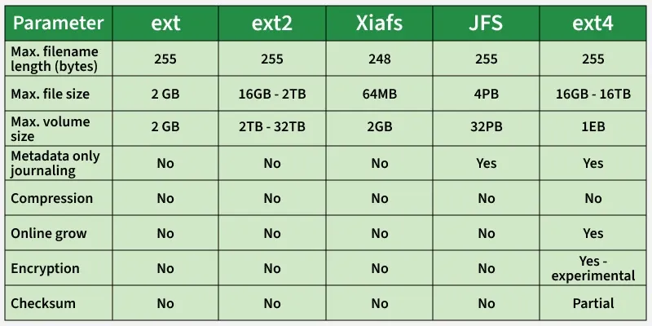
FileSystem Comparison

Slide 32
FS directory structure
/
/usr
/boot
/var
/opt
/tmp
/home

Slide 33
Linux Boot Process
BIOS/UEFI: Performs Power-On Self-Test (POST) to check hardware, then locates the bootloader on the hard drive or SSD.
MBR/GPT & Bootloader (GRUB): BIOS reads the Master Boot Record (MBR), while UEFI uses GPT. They load the GRUB2 bootloader, which displays a menu to select the kernel.
Kernel: GRUB loads the kernel into memory. It decompresses, mounts the root filesystem (often using initramfs for initial drivers), and initializes essential hardware.
Init Process (systemd): The kernel starts the first process, typically systemd (PID 1), which acts as the init system to manage all subsequent processes.
Runlevel/Target: systemd loads required services (networking, GUI) based on the target configuration

Slide 34
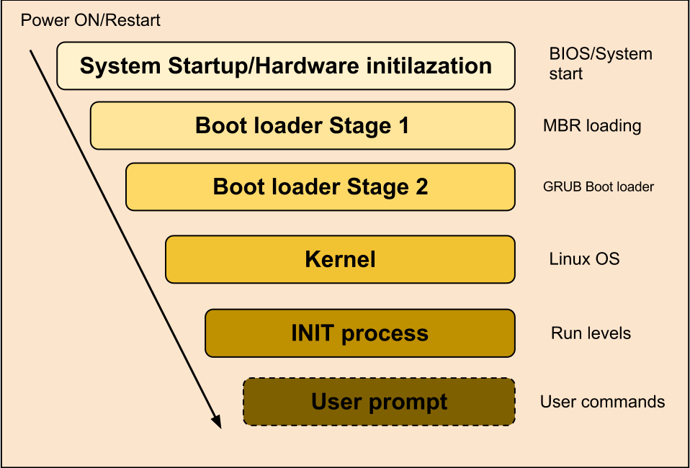
Linux boot Process

Slide 35
Reboot/Shutdown
To shutdown
Shutdown –h now
Poweroff
init 0
Halt
Shutdown –h +15 (minutes)
To Reboot
Shutdown –r now
Reboot
init 6

